Slide 1
CQRS & EventSourcing for mobile Apps

Slide 2
Modern App development
CQRS and StateStores
Flux
Redux
Elm

Slide 3
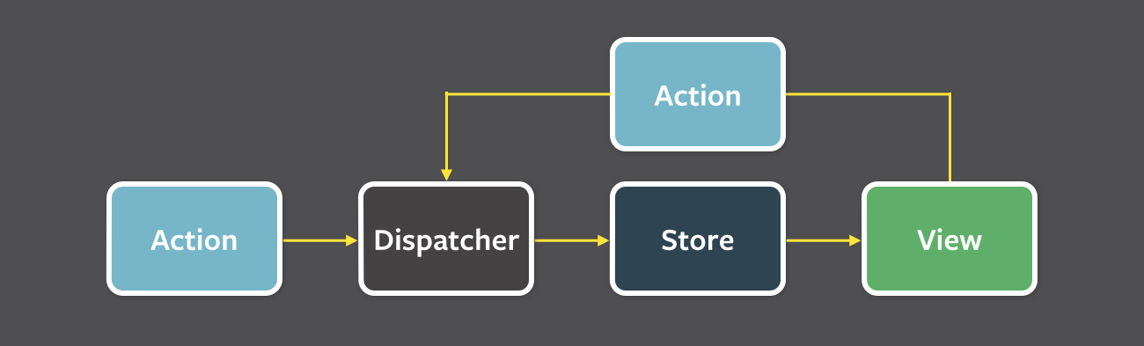
Flux

Slide 4
Redux

Slide 5
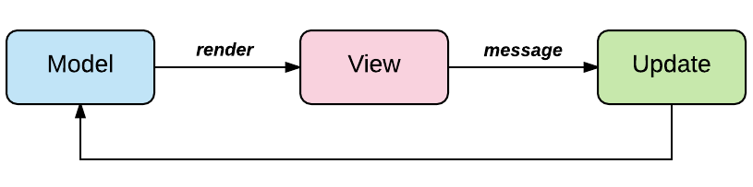
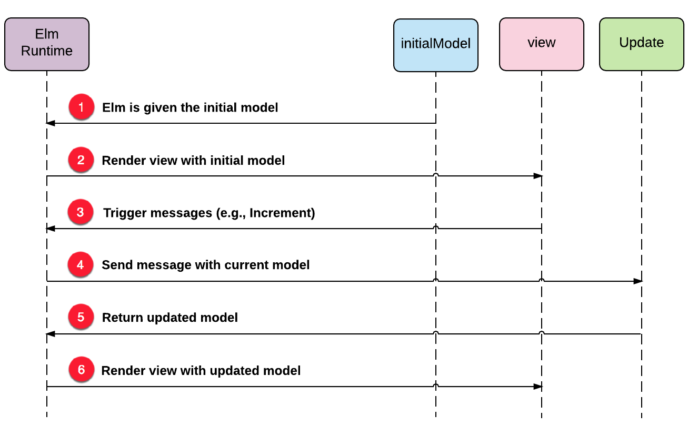
Elm

Slide 6
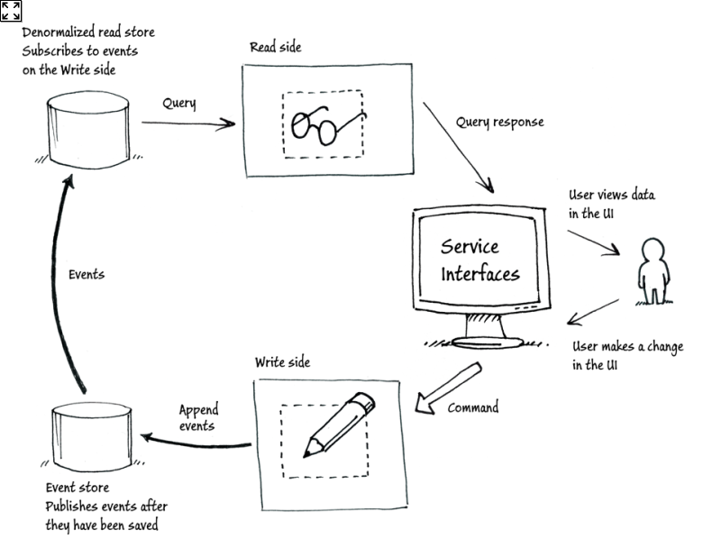
Event Sourcing & CQRS

Slide 7
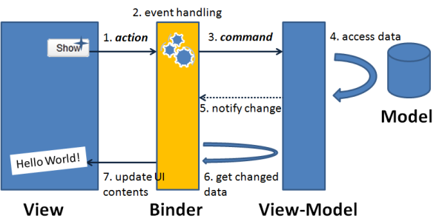
MVVM Model - view - ViewModel

Slide 8
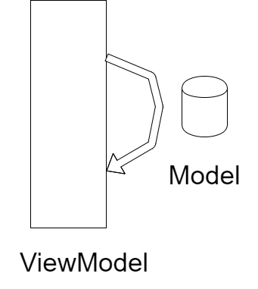
Hook into Model – ViewModel connection

Slide 9
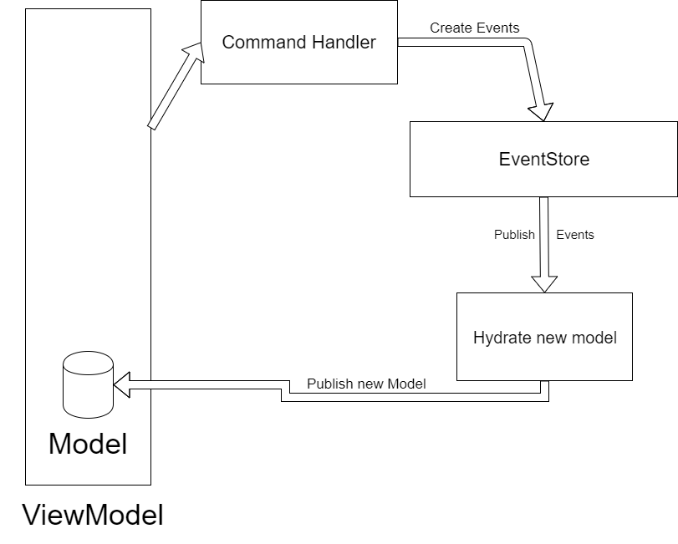
CQRS and EventSourcing

Slide 10
Demo

Slide 11
Thank you
Flux: https://facebook.github.io/flux/docs/overview.html
Redux: https://redux.js.org/
Elm: https://guide.elm-lang.org/architecture/
MVVM: https://en.wikipedia.org/wiki/Model%E2%80%93view%E2%80%93viewmodel

